Slide 1

Lampert Retail Inc.
Abhilekh Das
Gopal Bhutada
Mihir Saurkar
Mihir Singh
Mrinal Dhawan
Parichay Jain

Slide 2
Agenda
Background of Company
Auditing Process
Planning and Risk Assessment
Internal Control Test
Substantive Test
Auditor’s Opinion

Slide 3
Background of Company
LRI is a huge, once grand retailer, run by a hard driving, once grand hedge fund manager.
It has 789 stores all across the globe.
Company uses computerized Point of Sale cash registers for its sales system.
It uses an ERP system from German Company SAP for it's Financial Accounting.

Slide 4
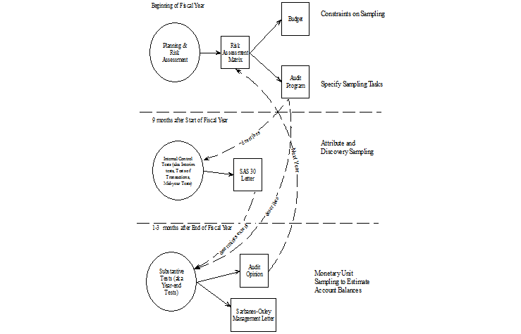
Auditing Process

Slide 5
Auditing Process
Beginning of the year: Planning and Risk Assessment
Budget Risk and Audit Program Risk
9 months after start of Fiscal Year : Internal Control Test
Result of assessment will determine the extent of substantive test
Last 3 months of the Year : Substantive Test
Issue Auditing opinion
Management will provide Sarbanes Oxley Management Letter

Slide 6
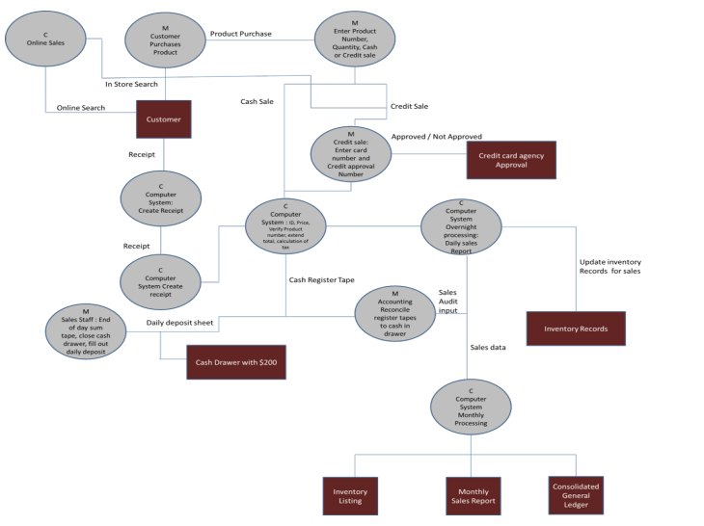
LRI’s Revenue Cycle System

Slide 7
Planning and Risk Assessment

Slide 8
Analytical Review
In order to perform an analytical review it is essential to compare some financial ratios with industry standards or historical performance.
Financial ratios can be broken down into four main categories
1.) Profitability or ROI
2.) Liquidity
3.) Leverage
4.) Efficiency
Based on the data that we have in the trial balance a few of these ratios is calculated and compared against industry standards in the following slide.

Slide 9
Analytical Review
Ratio | Trial Balance | Industry Standard
Annual inventory turnover (Cost of Goods Sold for the Year/Average Inventory) | 2.29 | 6
Gross profitability (Gross Profits/Net Sales) | 63.1% | 50%-60%
Sales to receivables or turnover ratio (Net Sales/Accounts Receivable) | 2.24 | 10
Inventory to assets ratio (Inventory/Total Assets) | 0.09 | 0.35
Cash to total assets (Cash/Total Assets) | 0.06 | -
Investment turnover (Net Sales/Total Assets) | 0.58 | 0.60
From the above it was observed that account receivables and sales are high risk account

Slide 10
Sample Size Suggestion
Performing the power analysis we get tolerable error (d) as 1000000/432000000 we get d = 0.0023, and the sample size is 1,168,727, based on the account balance stated in trial balance.
This sample size is too large for audit purpose. In order to make verification of Account Receivables more manageable using d=10%. The sample size thus obtained is 620.
This sample size is useable for both internal control and substantive tests. Verifying sample transactions help us identify the number of misstated accounts and make estimates based on the same.

Slide 11
Test of Internal Controls

Slide 12
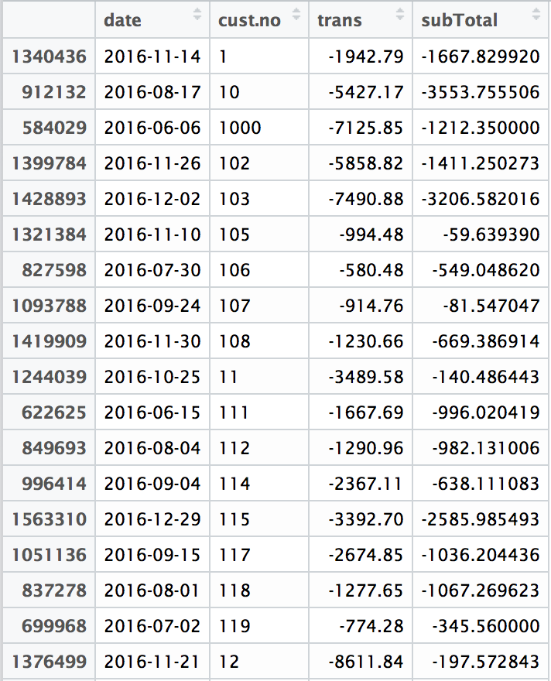
Customers Exceeding Credit Limit
There are 482 customers exceeding their credit limits

Slide 13

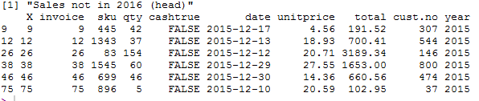
Integrity of Transactions
Duplicate Transactions
There are no duplicate invoices
Omitted Entries
There are 1,80,733 omitted invoices like :
Sales Cut off Test
There are 216533 transactions out of the auditing year like :

Slide 14
Substantive Tests

Slide 15
Trial Balance Re-computation
There were some material errors observed

Slide 16
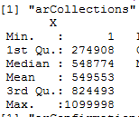
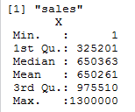
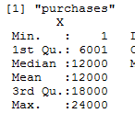
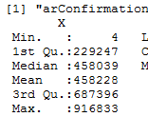
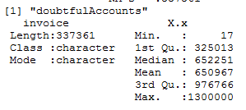
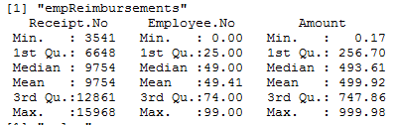
Statistical Summary
The distribution of all transactions are uniformly distributed

Slide 17
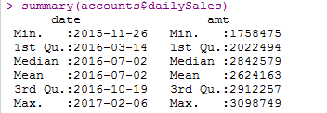
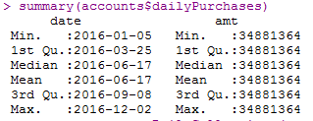
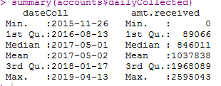
Date Range Check
There are date ranges outside the 2016 Fiscal Year that had to be filtered out
There was no change in trial balance as the proper ranges were already considered

Slide 18
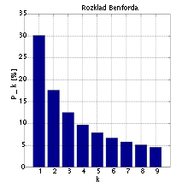
Employee Expenditures
Benford's test is used to find the abnormalities in the data sets.
It allows the auditor to evaluate the digits that make up the number themselves.
It is based on a fact that many numbers normally used in business are not random but rather flow some ordered progression.

Slide 19
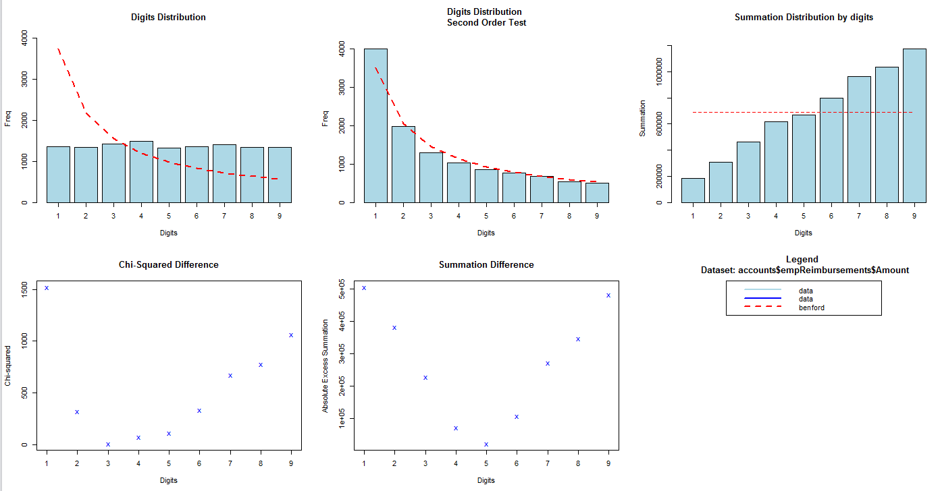
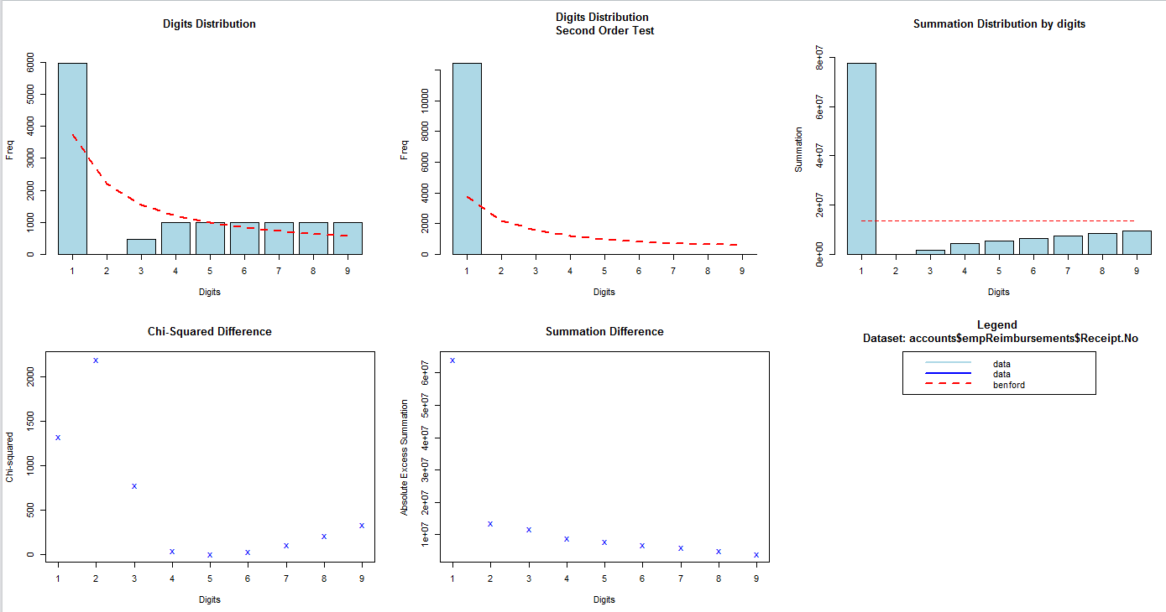
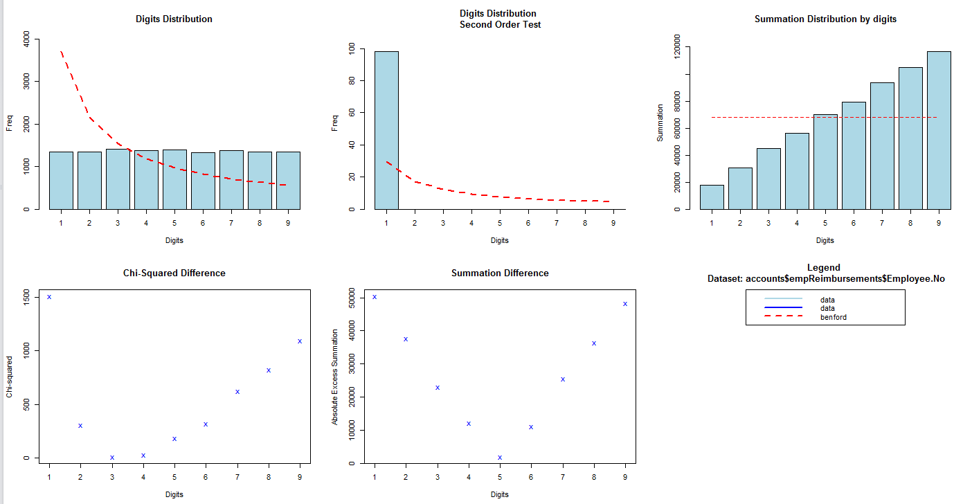
Benford’s Test
Amount
Receipt
Employee

Slide 20
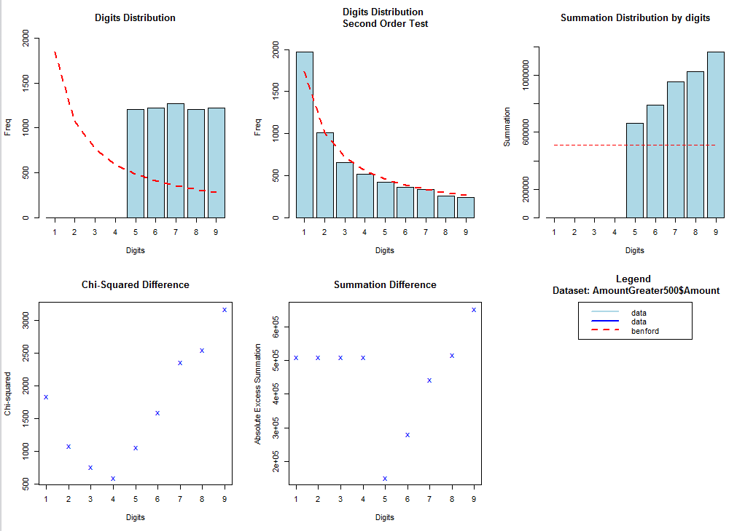
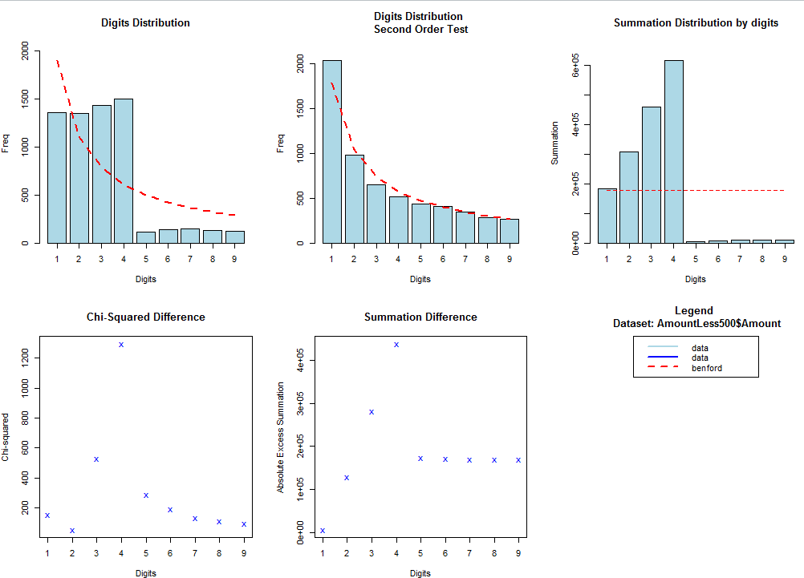
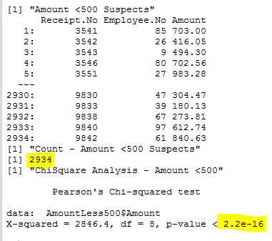
Benford’s Test
Amount Greater than 500
Amount Less than 500
Incorrect Receipts, Forged bills
Failure to Benford’s Law

Slide 21
Audit of Accounts Receivables
Accounts Receivable Outstanding
Allowance for Uncollectible Account
Customers Exceeding Credit Limit
Tolerable Error and Sampling
Conclusion

Slide 22
Accounts Receivable Outstanding
High Risk Account
Exceeds Tolerable Error

Slide 23
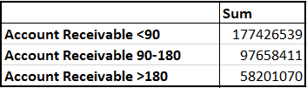
Allowance for Uncollectible Amount
Total Uncollectible Amount is $58398059
Unjustified Materiality Error

Slide 24
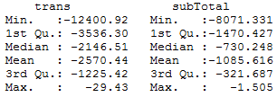
Customers Exceeding Credit Limit
There are 482 customers exceeding their credit limits
Since the distribution of total amount exceeded is normally distributed, we can see that all customers have same tendency

Slide 25
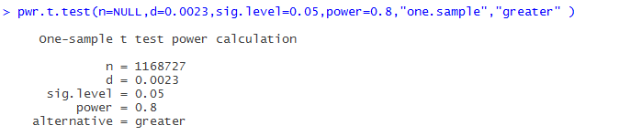
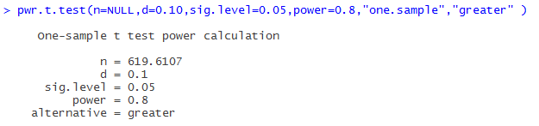
Sampling and Tolerable Error
Calculated tolerable error is of 0.0023 we get a large sample size for accounts
We use tolerable error as 10% and get sample size as 620.
We used monitory sampling (PPS)

Slide 26
Conclusion
There are 482 customers exceeding credit Limits.
We had performed a sales cutoff test, there were dates outside the fiscal period and so the results could have been overstated, but we filtered out those dates.
Based on the sampling process, we can say that the AR balance is Fairly Stated. But, according to the trial balance, the amount exceeds the tolerable error limit.

Slide 27
Audit of Inventory
Cost of Goods Sold
Average Sales Markup
Stockouts
Sample Analysis
Discrepancies
Aging of Inventory
Turnover

Slide 28
Audit of Inventory
Lower of Cost or Market Test
Net Realizable Value Analysis
Defective and Return Rate Analysis
Conclusion

Slide 29

COGS and Average Sales Markup
Cost of Goods Sold
“Matching Principle” plays a very vital role in computing LSI’s cost of good sold.
The amount of COGS calculated equals $350,802,594.
Average Sales Markup
The average sales markup on LSI’s inventory are stated as :

Slide 30
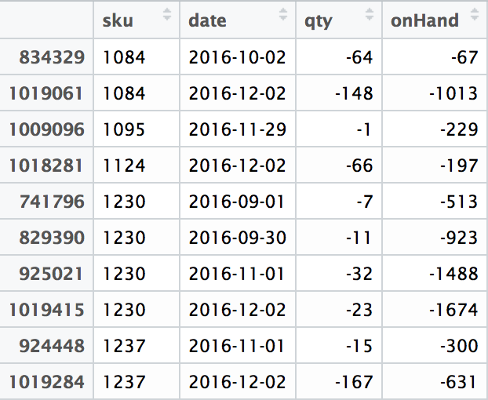
Stockouts
There are 63 inventory SKU’s which stocked out.
From the table we determine :
SKU’s that have stocked out
When they stocked out

Slide 31

Sample Analysis
There are 2000 SKU’s, using 10% of the sample size for analysis.
By sampling 200 SKU’s we tallied the inventory values with physical count and found 20% records not matching, by a non material amount.
We computed the dollar amount of the discrepancies and found it to be within tolerable error.
Since the distribution of total amount exceeded is normally distributed, we can see that all customers have same tendency

Slide 32
New Inventory Value
After adjusting the discrepancies, the new inventory value is – 153129104
The difference in value from the trial balance is – 364104 (within tolerable error).

Slide 33
Aging of Inventory
We assumed FIFO method of inventory
We allocated the inventory values in 3 bins, the result is summarized as below:
There are 4 inventory parts over 365 days, which accounted for $14,631.76 and should be written down

Slide 34
Inventory Audit
Turnover
All SKU’s have inventory turnover less than 10.
Lower of Cost or Market Value
There are no SKU’s for which market cost is less than cost, hence there is no need of mark down.
Net Realizable Value Analysis
There are 433 SKU’s for which Net realizable value is less than cost.
There are 587 SKU’s for which Net realizable value is less than 110% of cost (10% commission on cost)
The less turnover indicates slow moving inventory. It also tells that whatever is purchased is a lot more than required, thus improper inventory management.

Slide 35


Defective and Return Rate Analysis
After adjusting for discrepancies we calculated the actual Defective and Return rates for each SKU
We found that there were no SKUs with Defective rate greater than 20%
We found that there were no SKUs with Return rate greater than 2%

Slide 36
Audit Opinion - Adverse
Revenue recognition of Accounts Receivable is not according to GAAP rules
AR is misstated by nearly $99,131,980 which is beyond Tolerable Error limit
There are 180,733 omitted invoices in AR sales
We are giving Adverse Opinion due to significant miscalculations and interpretations in various statements

Slide 37
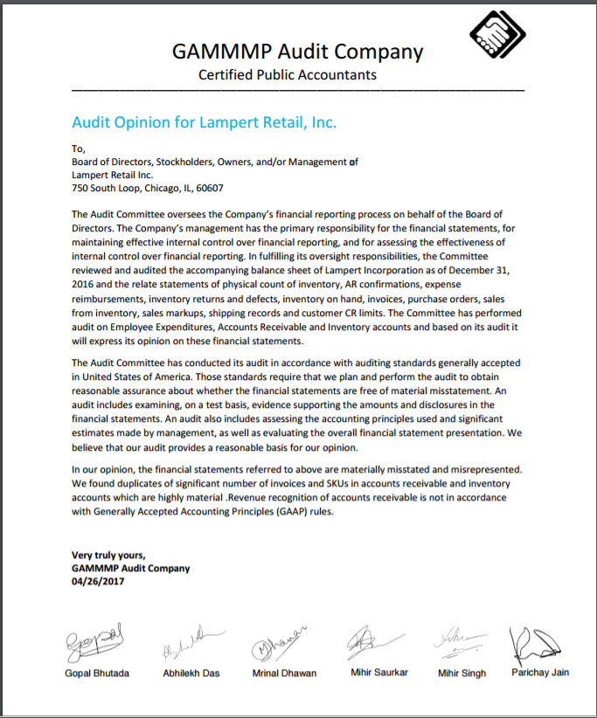
Audit Report

Slide 38
THANK YOU

